Slide 1
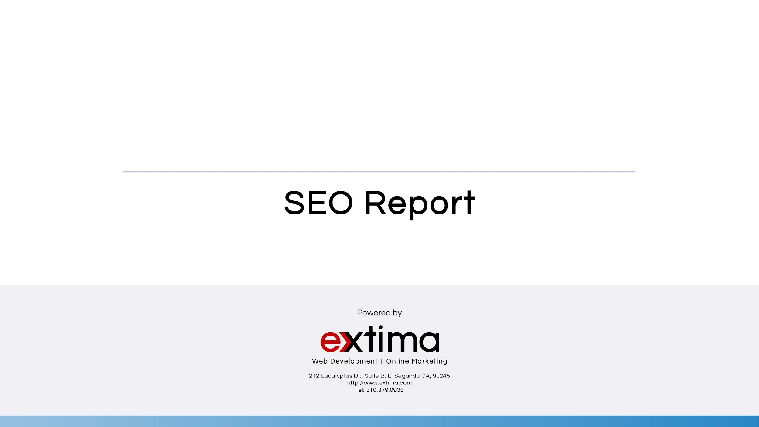

June/July 2019

Slide 2
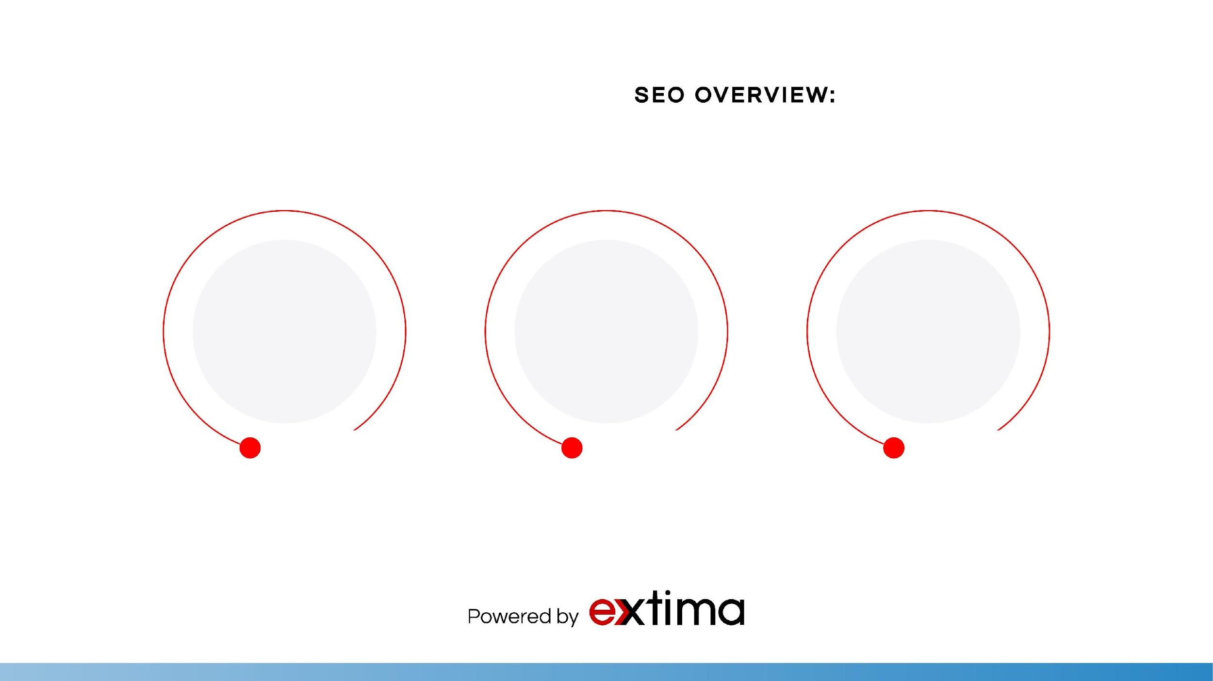
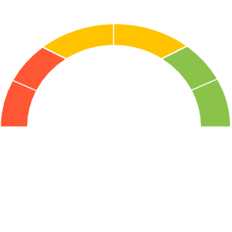
1,332
GOOD
2,398
1,072
Number of sessions to your webpage
Number of pageviews to your website
Number of users to your website

Slide 3
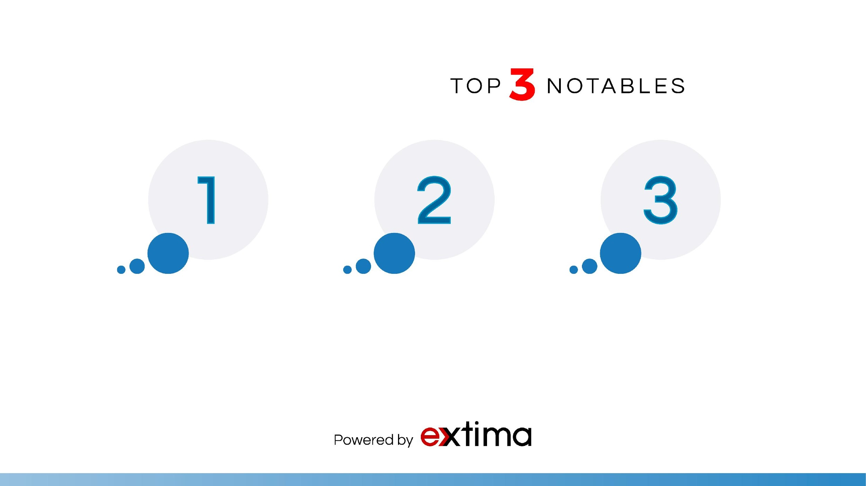



Organic traffic increased by +3%
Contact Form conversion increased by +9.74%
Bounce rate decreased by +8%

Slide 4
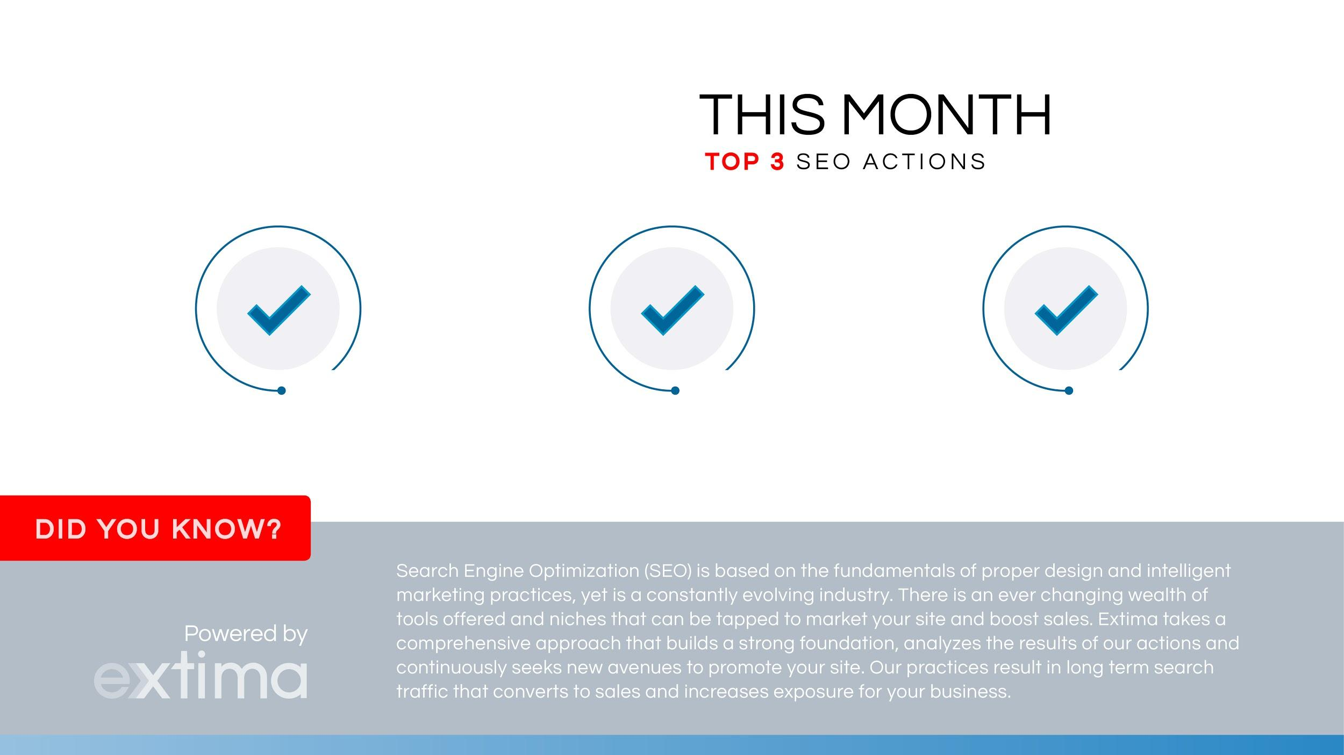
Optimized blog posts and pages to increase keyword rankings.
Re-submit URL links of optimized pages to Google
Checked for broken links in Google Search Console

Slide 5

Organic search traffic brought in 220 users this month—a +3% increase. Paid Search traffic brought in +446 users and Direct brought in +224.
This month, we focused on SEO-optimizing blog pages. We also shared blog pages and optimized backlinks on different business profiles to help increase brand awareness. This month, we didn’t see movement in keywords. Normal rank movement is one to two ranks up and down. This is due to other competitors targeting the same keywords as us.
This month, we kept an eye on the Google search console (formally Webmaster Tools) to be sure there were no broken links nor major issues with the site.

Slide 6

Next month, we will focus on optimizing product pages with more organic keywords. The goal is to gain as many organic keywords related to the “music production” industry as possible.
Next month we will focus on adding/removing keywords that will be suited for the website’s organic search results. We are looking at keywords such as: music production recording academy, music production mixing academy and los angeles music production academy.
We will also continue to build local links to ensure a solid web presence and more exposure. Local links help boost your local search rankings, improve your domain authority, and ultimately, send you valuable traffic. We strive to build at least five strong online business profiles a month. We conducted analytical performance research for keywords ranking close to page one to help us going forward. As always, we will continue monitoring site activity and the Google Search console for website errors.

Slide 7
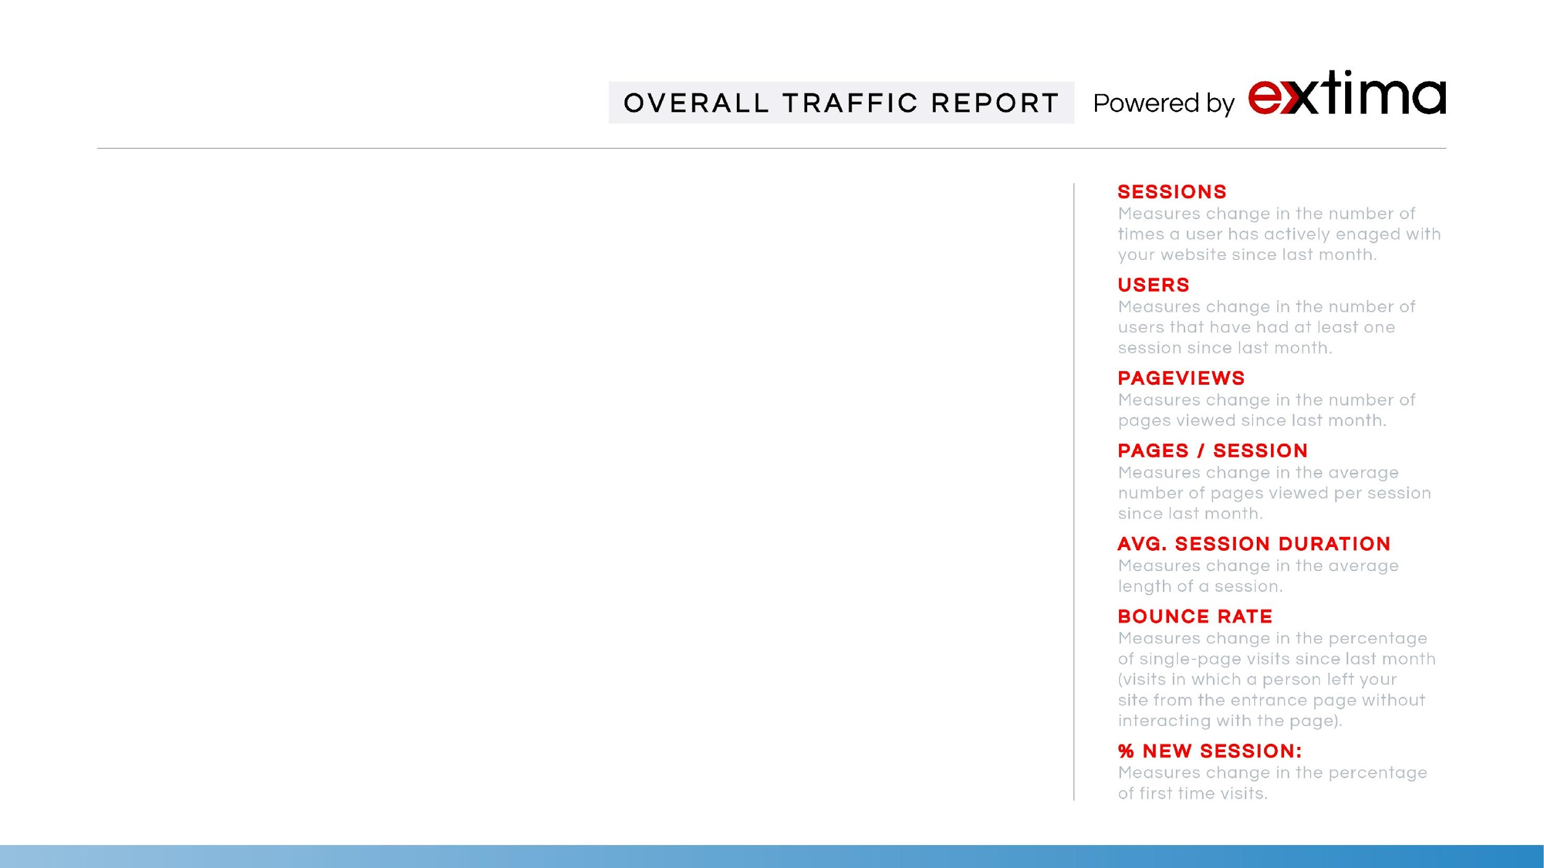
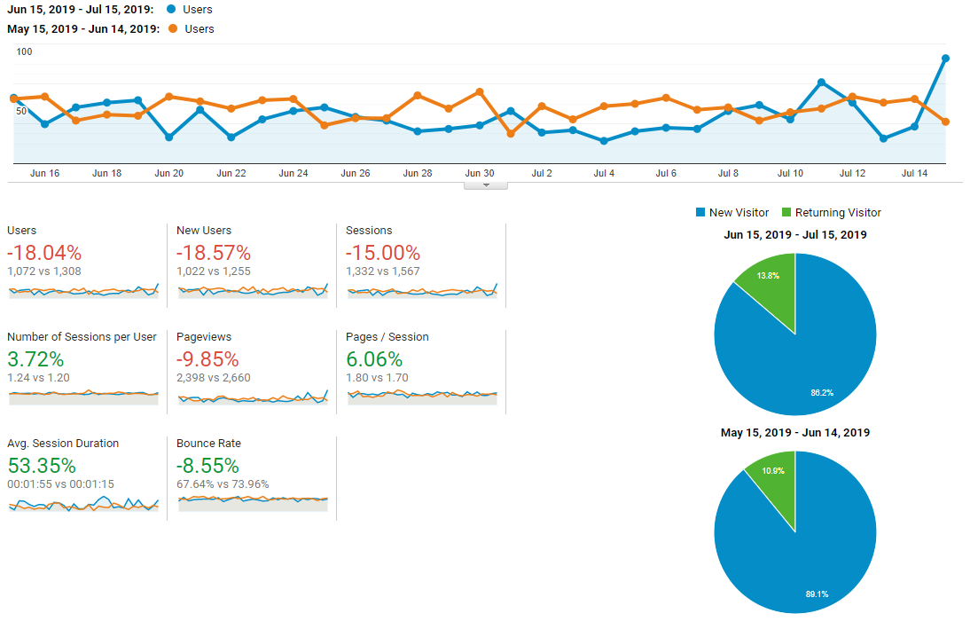

Slide 8
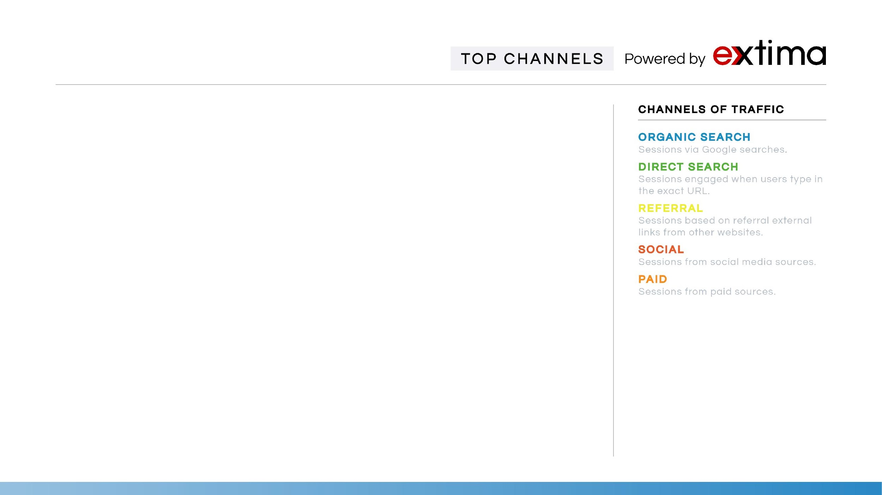
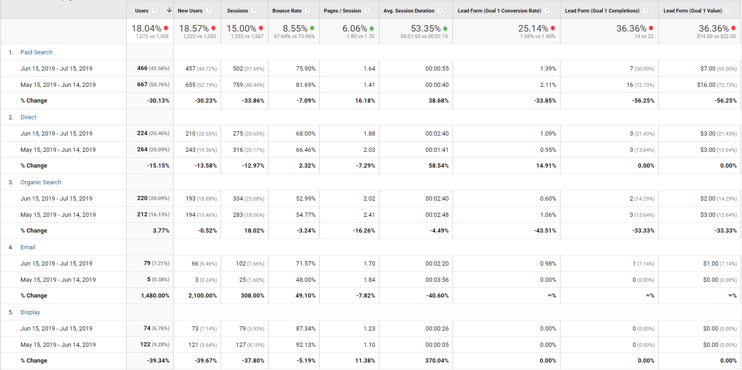

Slide 9
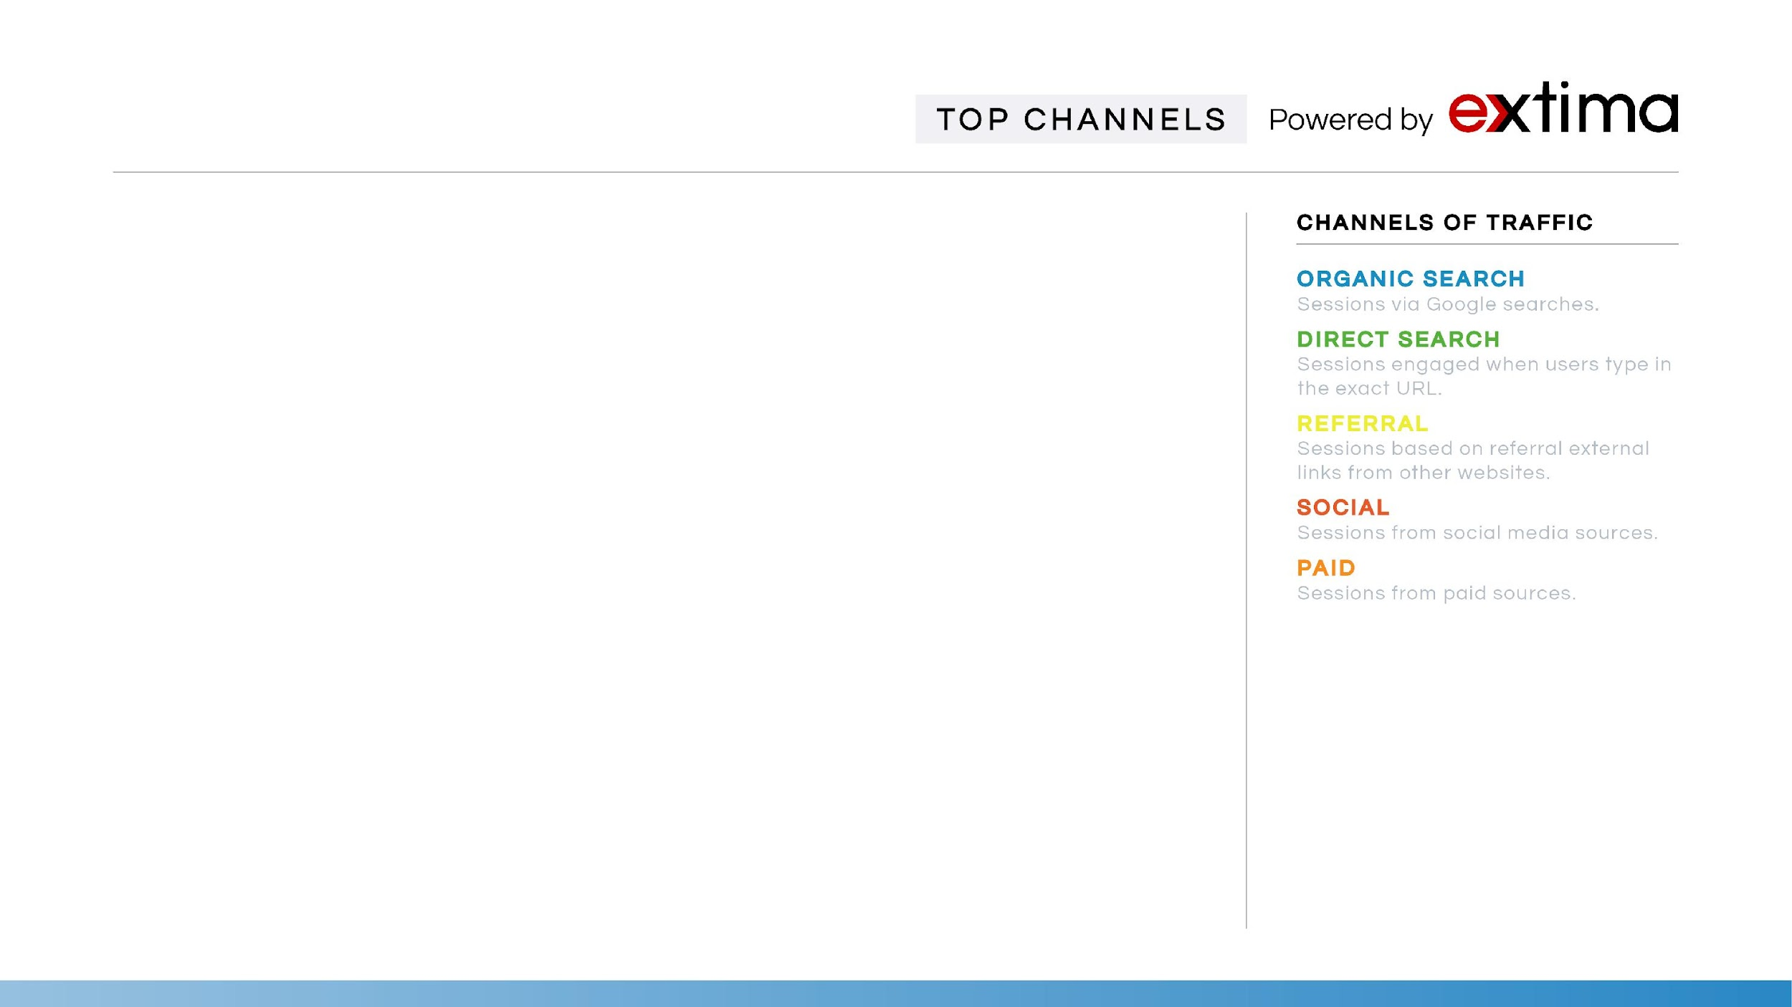
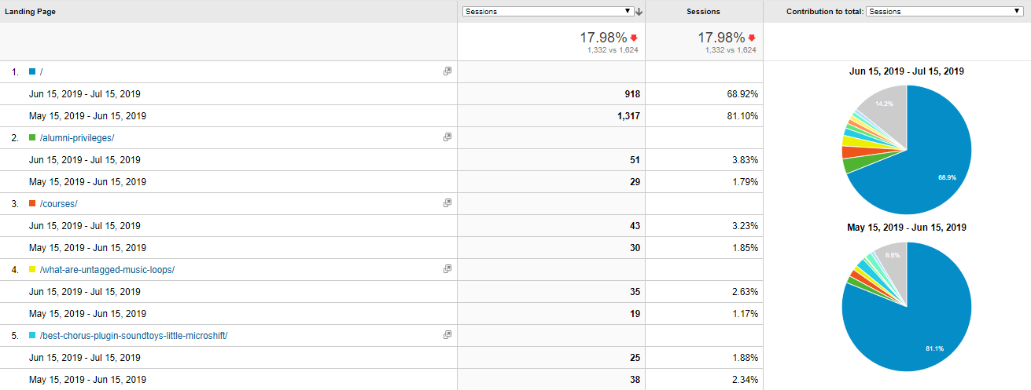
TOP LANDING PAGES

Slide 10
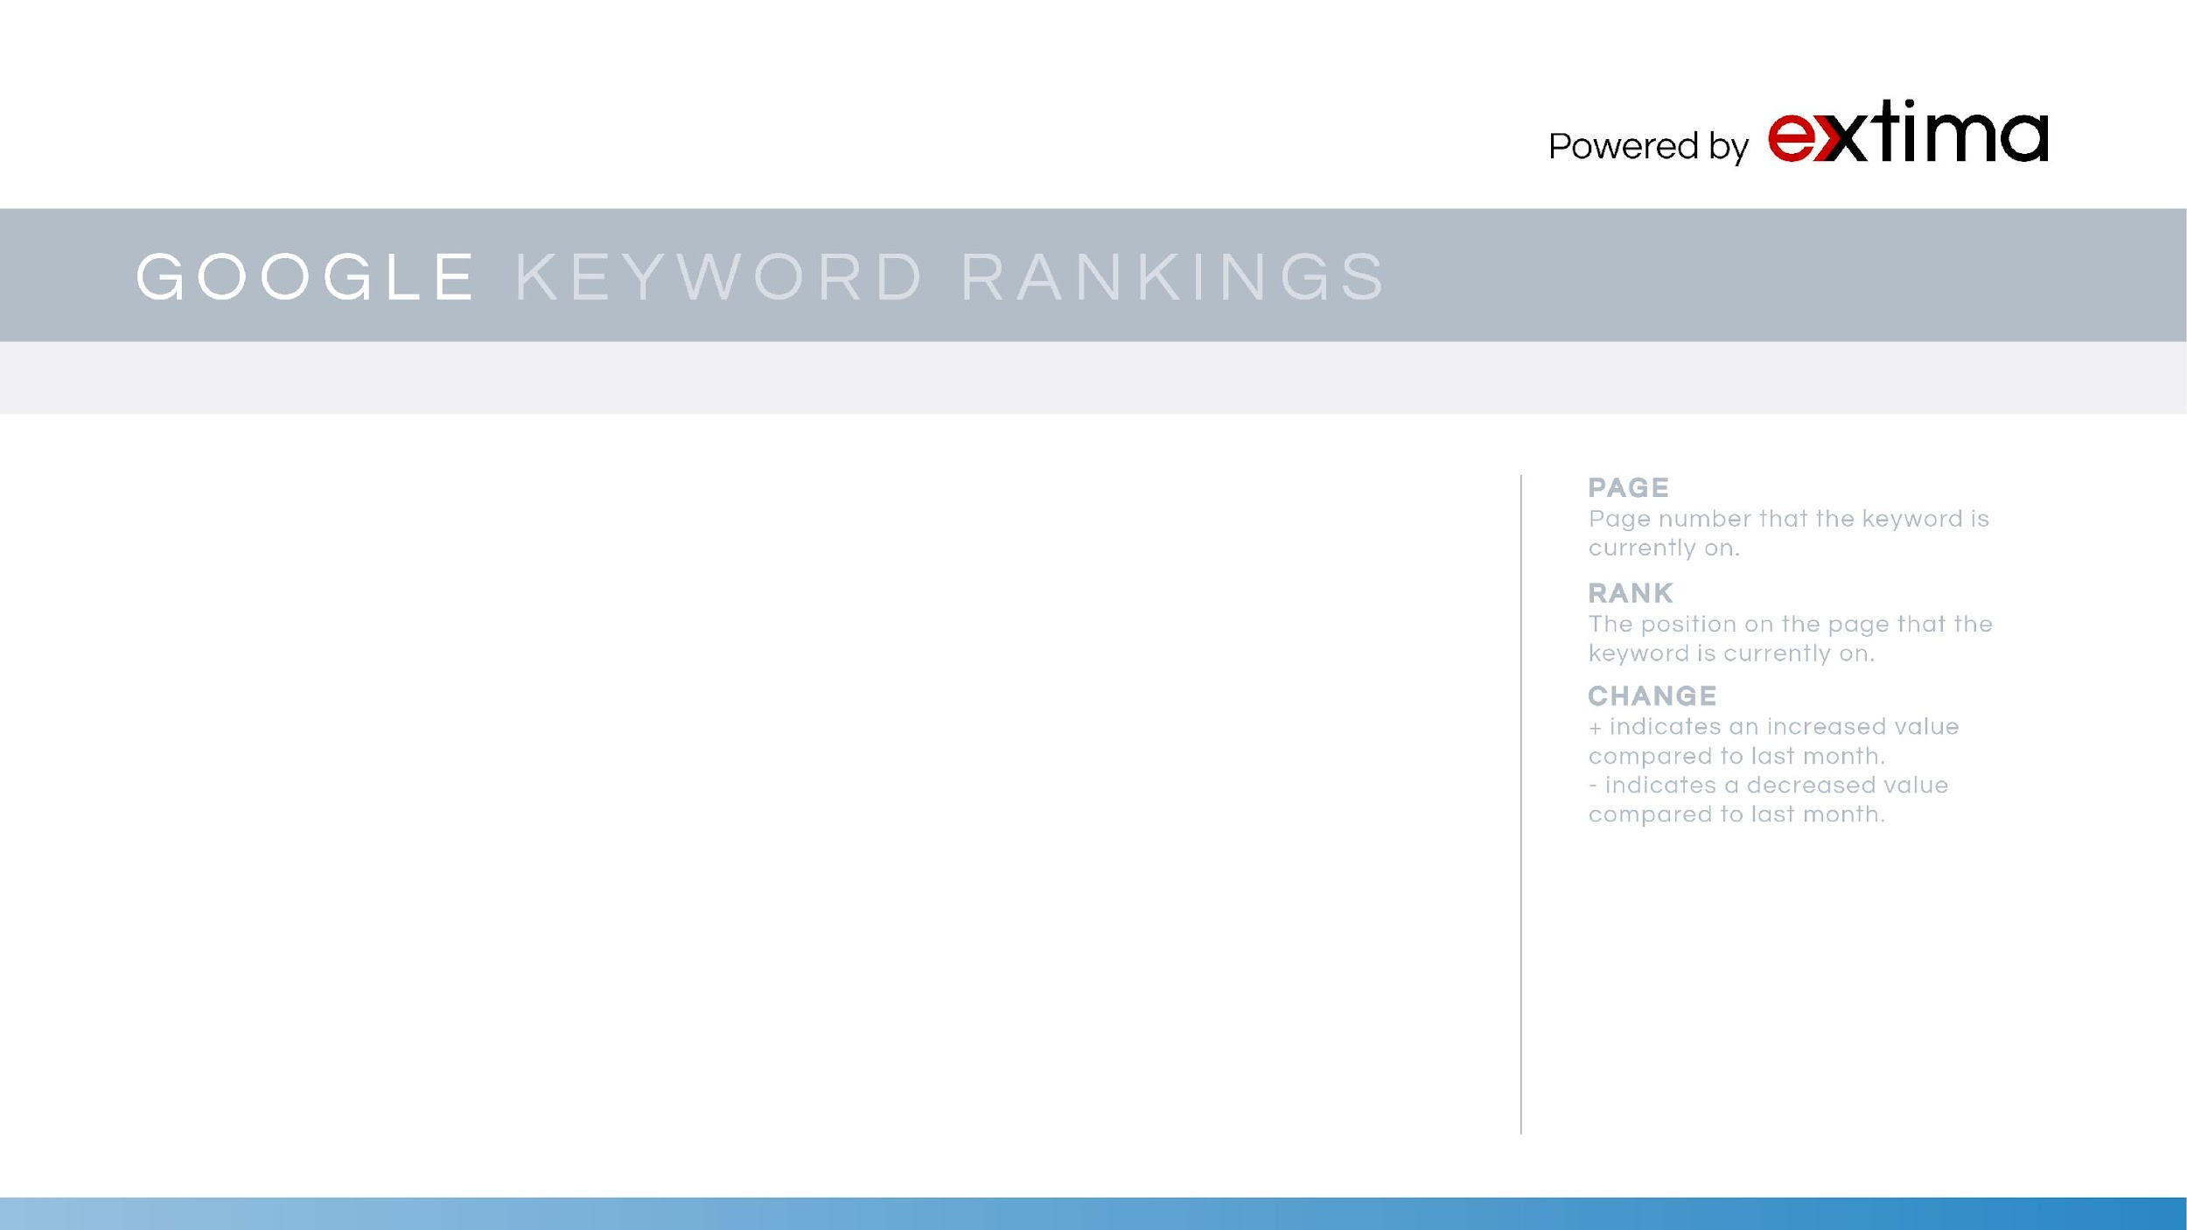
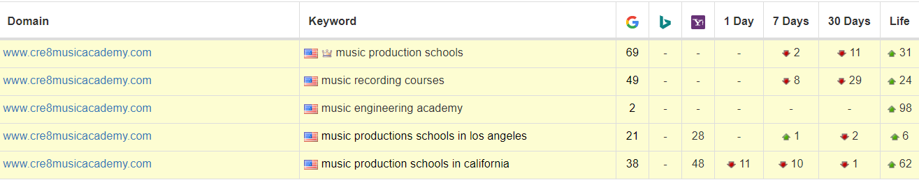
GOOGLE & BING KEYWORD RANKINGS

Slide 11
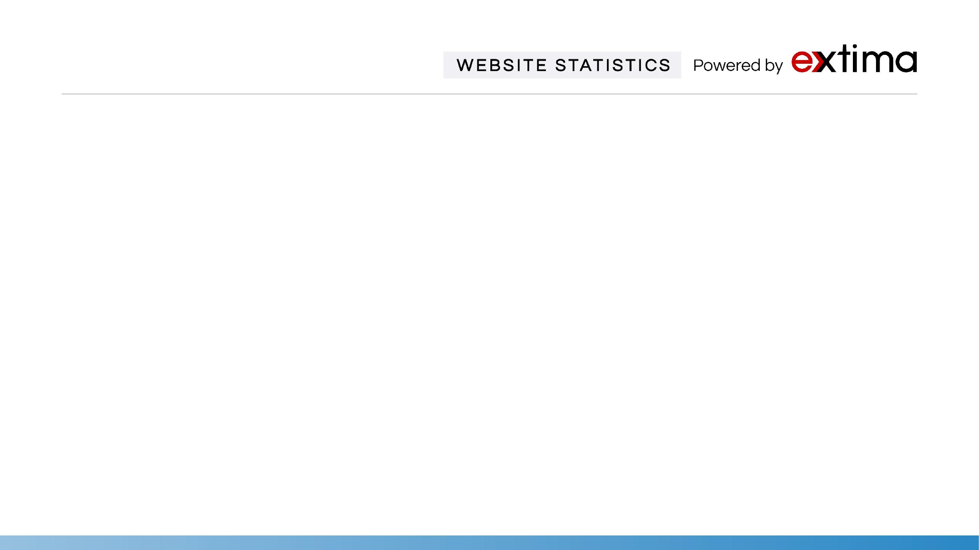
Statistics | May | Jun | July | Comments
Google Index | 118 | 155 | 83 | Google Index is the number of links currently indexed in Google’s database.
Marketing Grade | 77% | 77% | 66% | Market Grader uses a blend of different variables, including site performance, Mobile design, SEO, and Security.
Ranking Keywords | 114 | 117 | 216 | Home Page Rank shows how strong a backlink profile is relative to your home page.
Domain Rank | 18/100 | 18/100 | 18/100 | Domain Rank shows how strong a backlink profile is relative to your whole site.
Linking Root Domains | 55 | 55 | 46 | Total number of websites linking back to your website.
Total Links | 143 | 148 | 139 | Total number of links driving traffic to your site. We will continue a campaign to aggressively acquire more links.
Alexa Rank | 6.39M | 10.1M | 5.10M | Alexa measures relative traffic levels. A low rank suggests high traffic levels and an important website.

Slide 12


